Slide 1
Coordinate Systems and Transformations

Slide 2
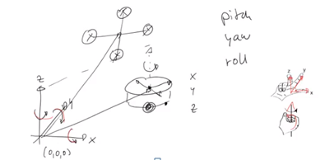
Coordinate Systems and Frames of Reference

Slide 3
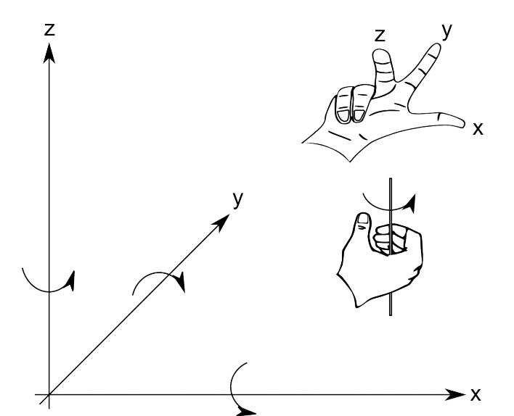
Coordinate Systems and Right-­‐Hand Rule

Slide 4
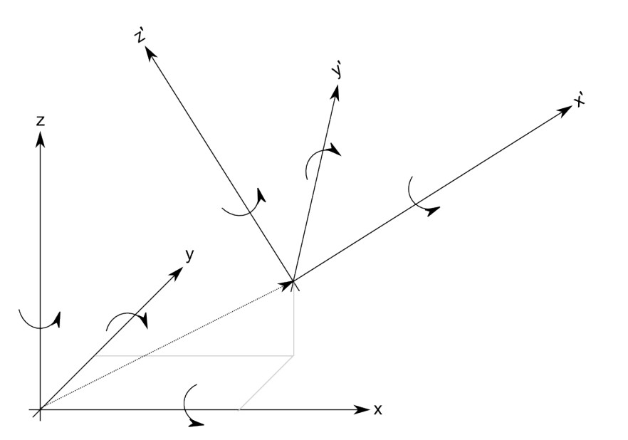
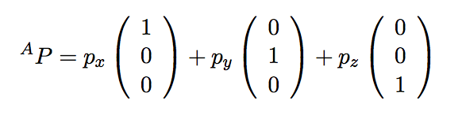
Nested Coordinate Systems (Frames of Reference)
P
{A}

Slide 5
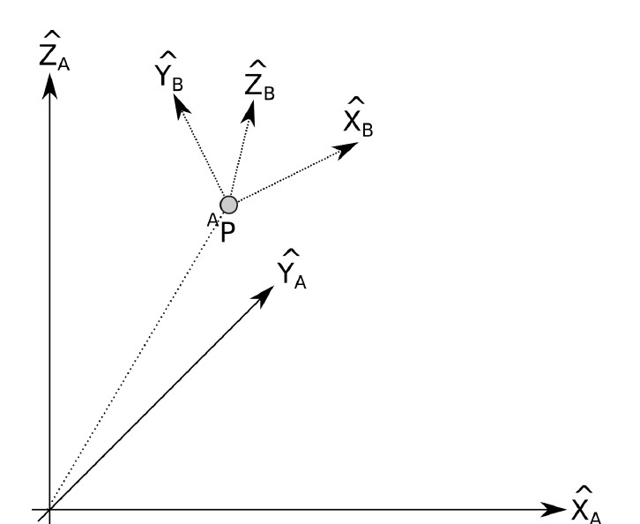
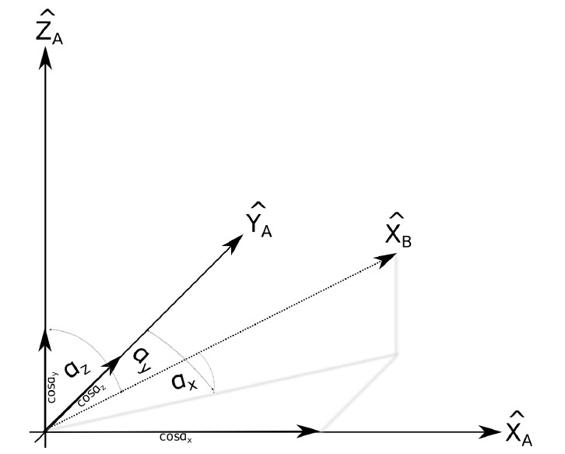


Expressing Rotations
“Express X_{B} in the coordinate frame A”

Slide 6
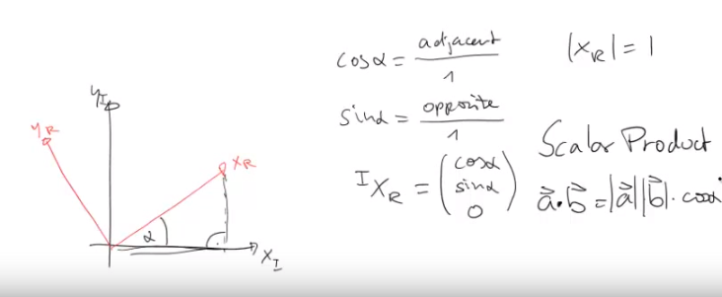
Coordinate transformation

Slide 7
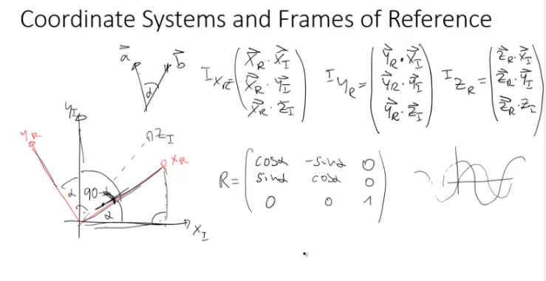
Matrix notation: Rotation

Slide 8
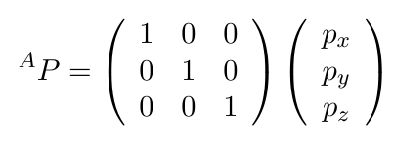

Transformation Arithmetic
Rotation Matrix
Euler Angles
Inverse

Slide 9


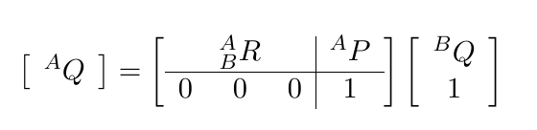

Mapping from one frame to another
Coordinate system B with respect to A
Homogeneous Transform
Inverse of homogeneous transformation

Slide 10
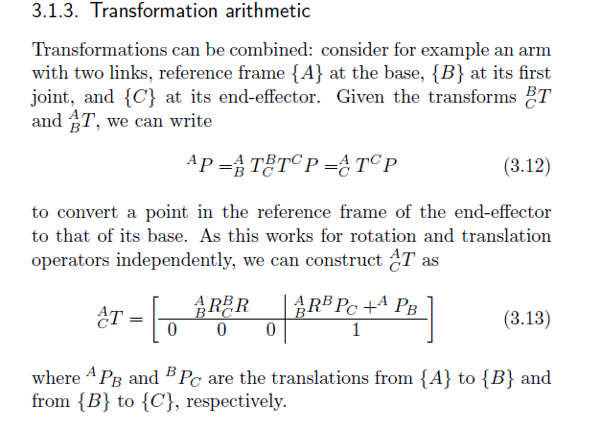
Combined transformations

